Slide 1
Covid19 in California in 2021
Kyra Achee, Belay Kondidie, Katherine Winder, Diego Lazaro

Slide 2
Hypotheses:
Counties with higher population density will have more deaths per 100,000 people
Counties with lower median income will have more deaths
Counties with a higher percentage of racial minorities will have more deaths per 100,000
Vaccinated people will have fewer cases and deaths than unvaccinated people

Slide 3
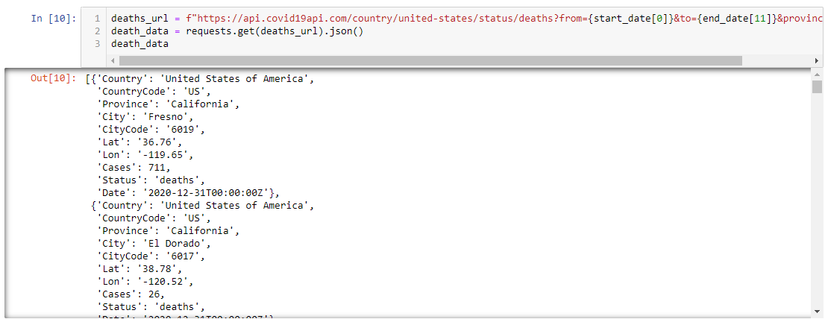
Retrieving Covid Data

Slide 4
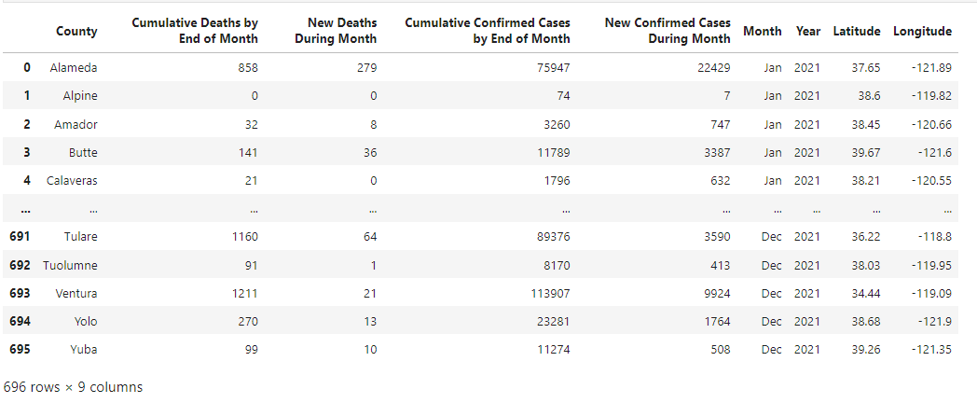
Data Frame

Slide 5
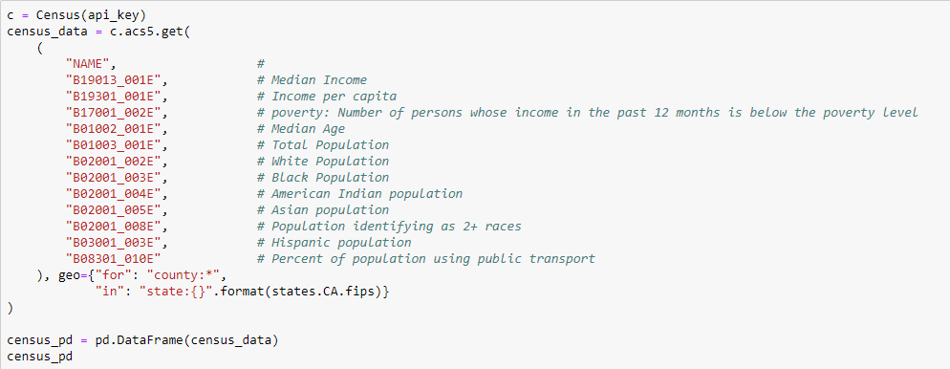
Retrieving Census Data and Land Area Data

Slide 6
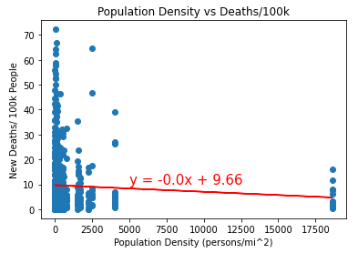
Do counties with higher population density have more deaths per 100,000 people?
P value = 0.140

Slide 7
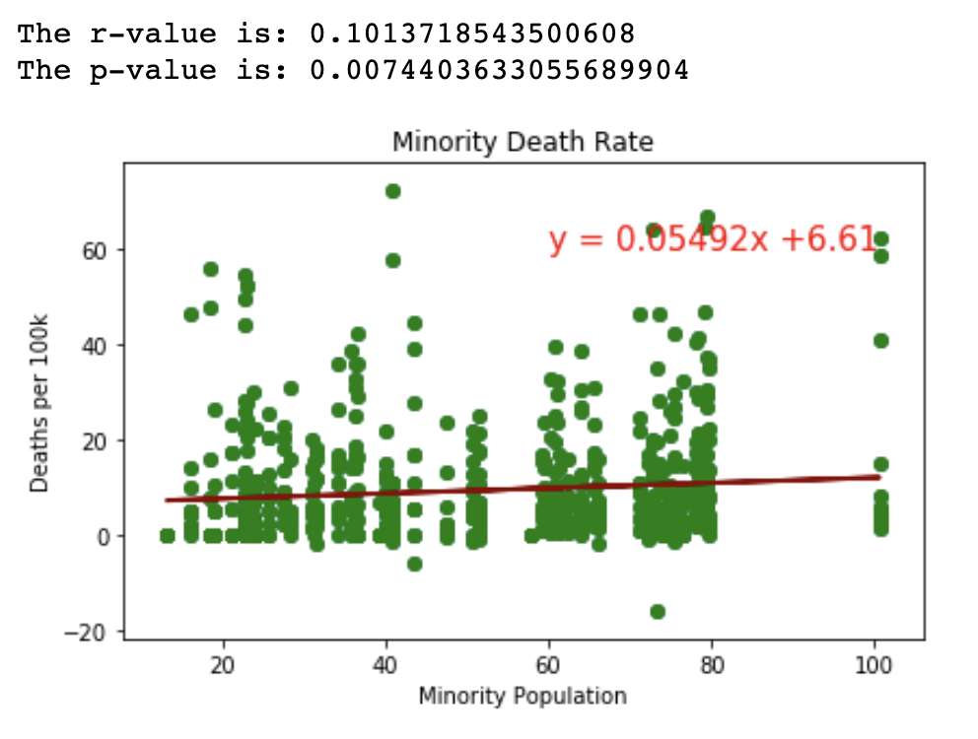
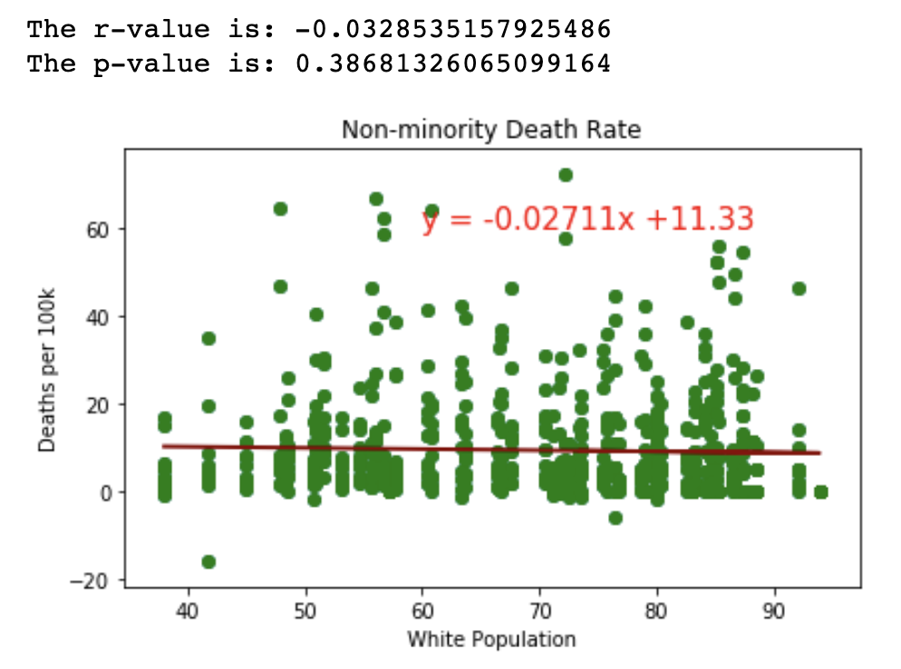
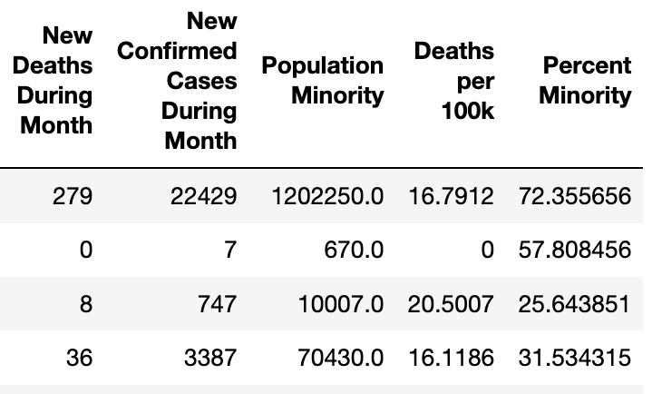
Are minority populations impacted more than non-minority populations?
The higher the minority population the slightly higher the deaths per 100k.
The higher the white population the slightly lower the deaths per 100k.

Slide 8
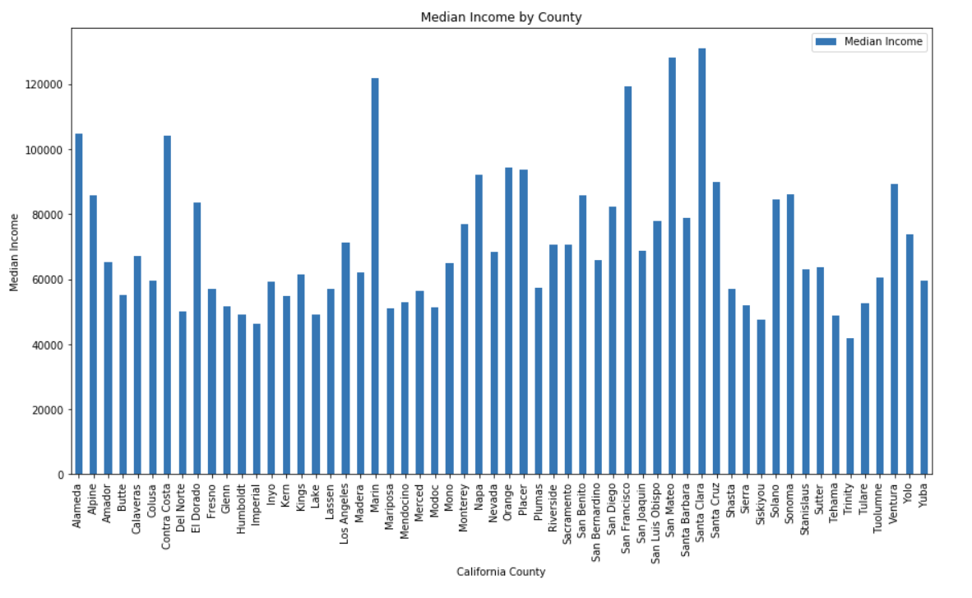


Does lower median income result in higher death rates?
Lowest median income: Trinity County
Highest median income: Santa Clara County

Slide 9
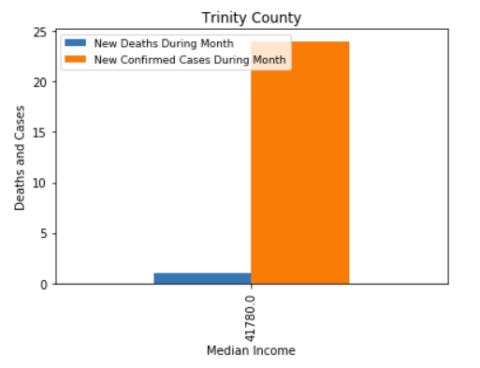
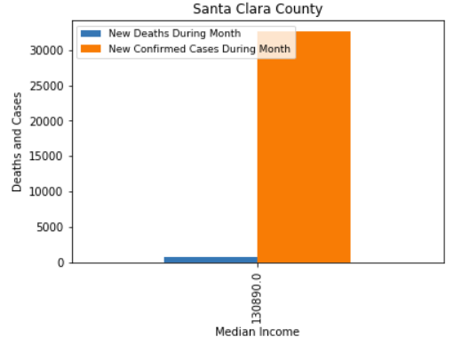
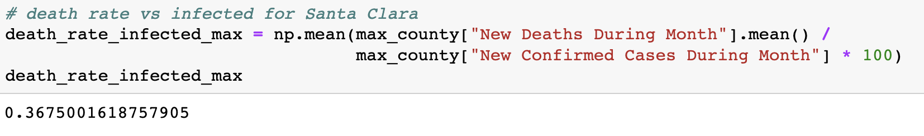
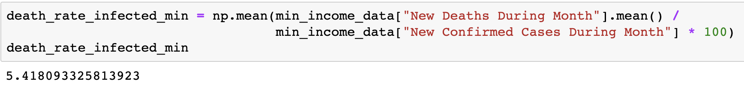
In Trinity County, 5.42% of the population infected with Covid died.
In Santa Clara County, 0.368% of the population infected died.
Notes:
Of those infected with Covid-19, 5.42% of the Trinity County population died on average while only .37% of the Santa Clara population died. Our hypothesis is correct that counties with a lower median income will result in more deaths per capita from Covid-19 than counties with a higher median income.

Slide 10



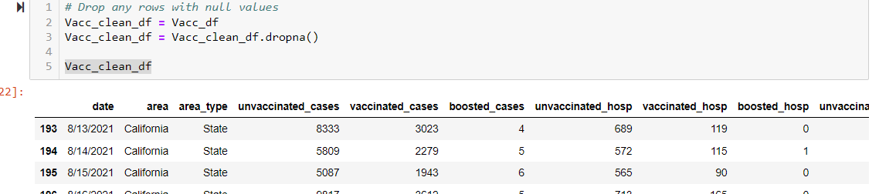
Covid vs biogeographic and vaccination
Inspected and helped to clean data gathered by a team member
Conducted data mining and cleaning on Covid vs vaccination data and shared the data and to member through github
Performed data analysis and visualization
Examples of codes used

Slide 11
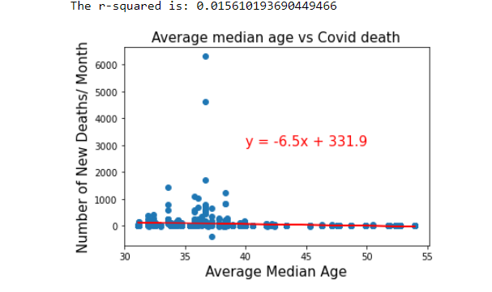
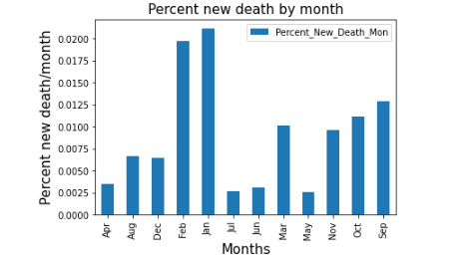
Covid deaths by average age and month
The p-value is: 0.3753576024621348
- No significant correlation b/n age and covid cases/month
- Covid death were significantly higher in Feb and Jan compared to other months of the year in 2021

Slide 12
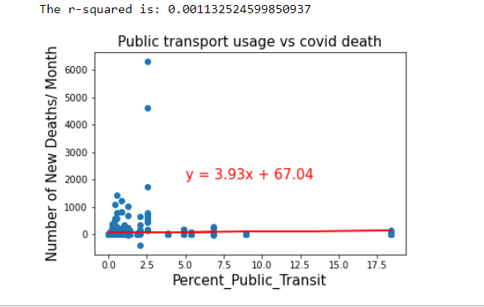
Public transport usage vs covid cases
NO Significant correlation between using public transport and number of covid cases

Slide 13
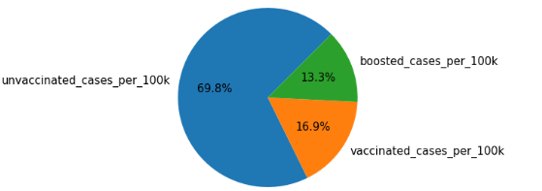
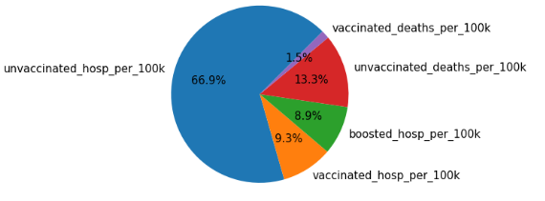
Covid cases per 100k vs vaccination status
Covid cases and hospitalization was higher in unvaccinated people compared to vaccinated ones
Unvaccinated people have more chances of death than vacc.
Boosted people have low covid related issues compared to unvaccinated and those don’t get booster shots

Slide 14
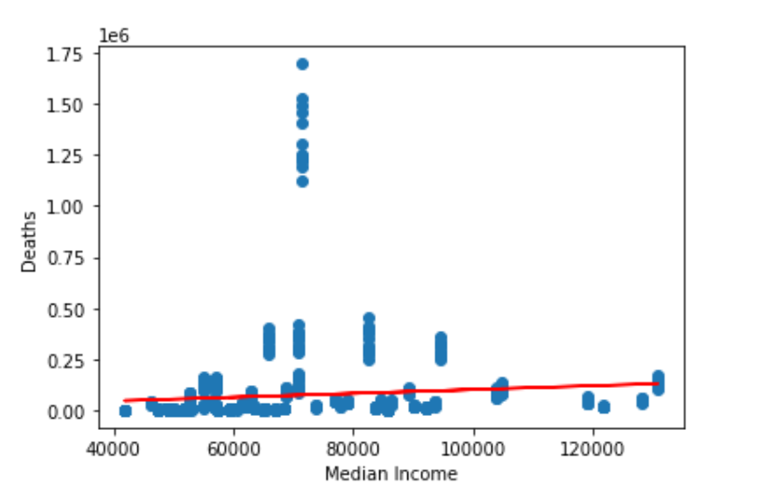
Median Income vs Cumulative Deaths by End of Month
The r-value is: 0.010956162489255274
The r-value is: 0.010956162489255274
TheThe r-vThe r-value is: 0.010956162489255274alue is: 0.010956162489255274r-value is: 0.010956162489255274

Slide 15
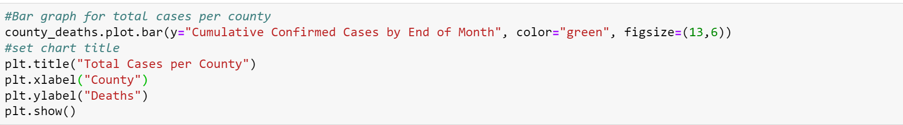
Total Cases per County

Slide 16
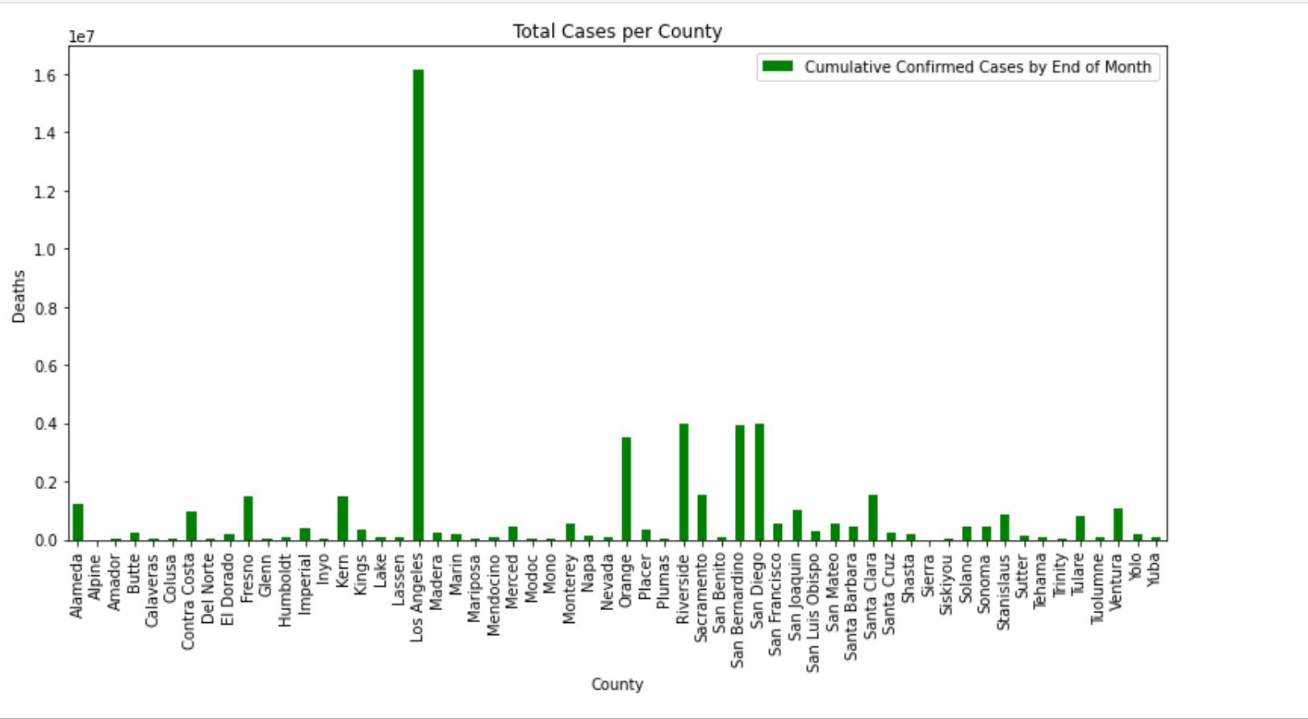
Total Cases per County

Slide 17
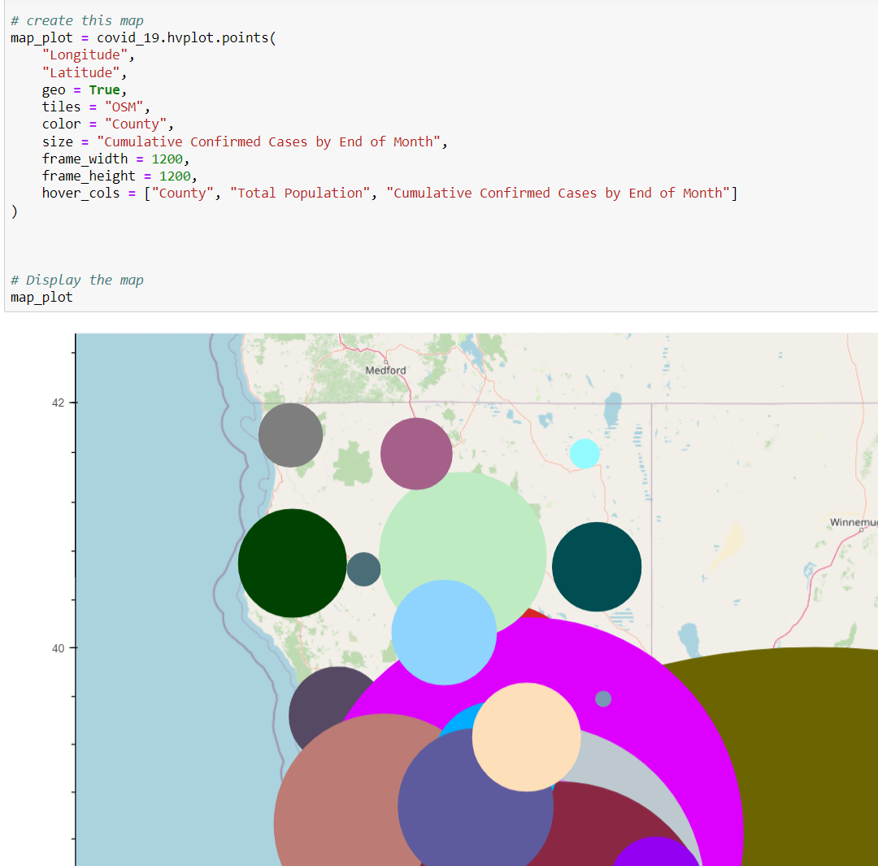
Challenge: Figuring out how to resize the “Cumulative Confirmed Cases by End of Month”

Slide 18
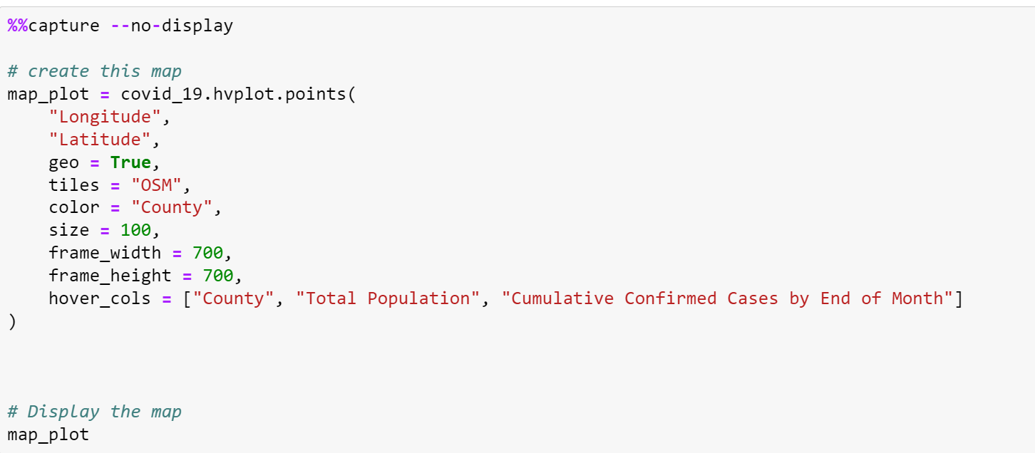

Slide 19
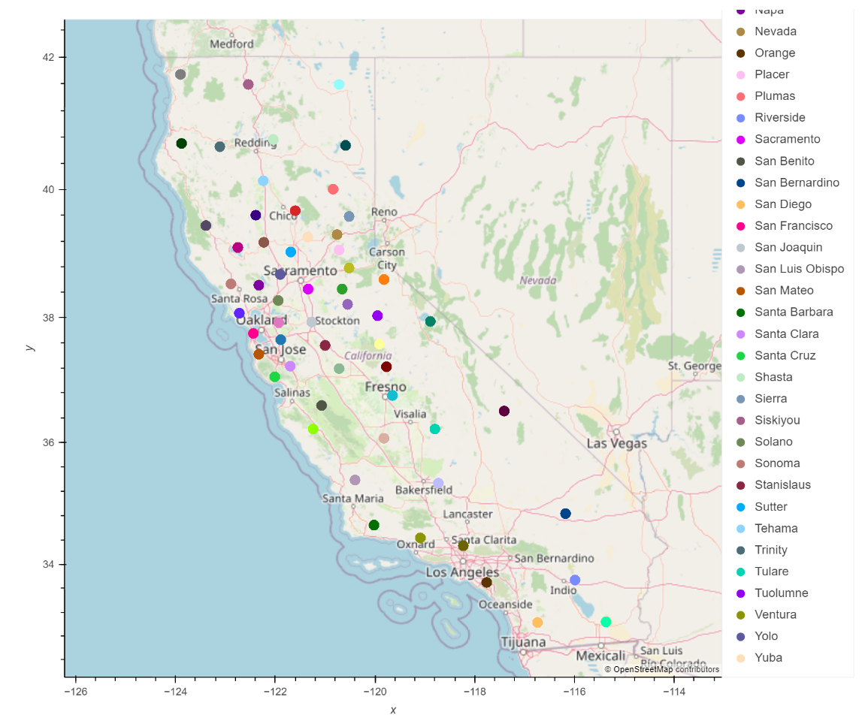

Slide 20
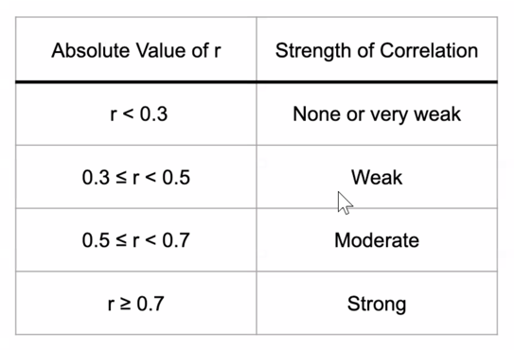
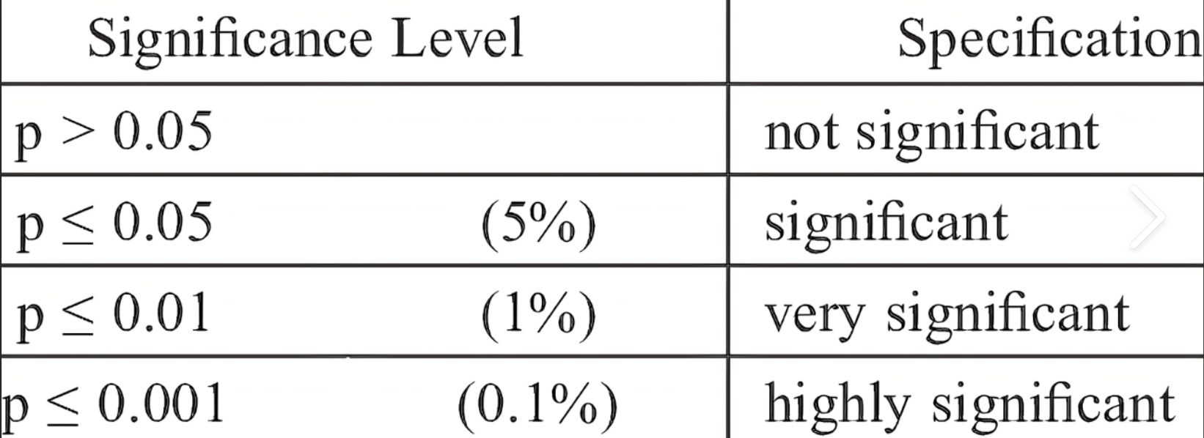
Conclusion
Counties with lower median income will have more deaths: No, r value was 0.01095 (very weak)
Counties with a higher percentage of racial minorities will have more deaths per 100,000: Yes, p-value was 0.0074 (highly significant)
Vaccinated people will have fewer cases and deaths than unvaccinated people. Vaccinated people had fewer hospitalizations than unvaccinated people per pie chart at 9% to 16%
Counties with higher population density will have more deaths per 100,000 people. No, populations with higher density did not have more deaths. P value was 0.140. Not significant.
is: 0.010956162489255274

Slide 21

Questions

